Slide 18
Mean
➢Sum of all the values in a dataset divided by the number of values in that dataset
➢This is also known as the “arithmetic average”
➢Dataset = 54, 54, 54, 55, 56, 57, 57, 58, 58, 60, 60
➢54+54+54+55+56+57+57+58+58+60+60 = 623
➢623/11 = 56.6
➢Mean = 56.6

Slide 19
Median
➢Median is the middle value in a dataset, when it is arranged in ascending or descending order
e.g.
➢b = 52 53 54 55 5658 60 62 65
➢Median=56
➢d = 65 55 89 56 35 14 56 55 87 45
➢d = 14 35 45 55 55 5656 65 87 89
➢(55+56) / 2 = 55.5
➢Median = 55.5

Slide 20
Mean Vs Median
➢Mean can be influenced by the outliers
➢b = (4, 5, 4, 5, 4, 20), Mean is 7
➢Median is 4.5
➢Median is much closer to most of the values in a dataset

Slide 21
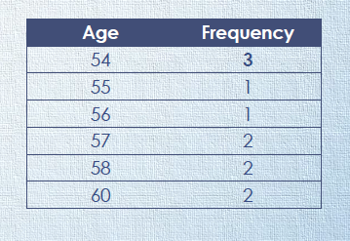
Mode
➢The value that occurs most frequently in a dataset
➢Age = 54 55 54 54 56 57 57 58 58 60 60
➢Mode = 54

